Slide 1
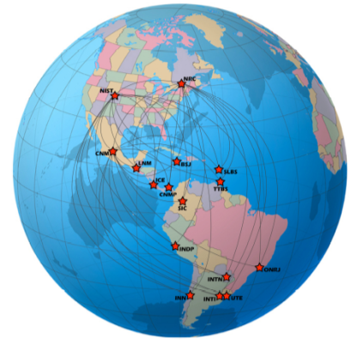

A NEW ALGORITHM FOR CLOCK WEIGHTS
FOR THE SIM TIME SCALE
J. Mauricio Lopez R.¹, Michael A. Lombardi², N. Diaz-Muñoz¹ and Eduardo de Carlos Lopez¹
¹Centro Nacional de Metrología (CENAM), Querétaro, Mexico
²National Institute of Standards and Technology (NIST), Boulder, Colorado, United States,

Slide 2
A NEW ALGORITHM FOR CLOCK WEIGHTS
FOR THE SIM TIME SCALE
J. Mauricio Lopez R., Michael A. Lombardi, N. Diaz-Muñoz and Eduardo de Carlos Lopez
OUTLINE
1. Motivations
2. The SIM Time Network (SIMTN)
3. The SIM time scale (SIMT)
4. New weights algorithm
5. Conclusions and future work

Slide 3
A NEW ALGORITHM FOR CLOCK WEIGHTS
FOR THE SIM TIME SCALE
J. Mauricio Lopez R., Michael A. Lombardi, N. Diaz-Muñoz and Eduardo de Carlos Lopez
OUTLINE
✓
1. Motivations
2. The SIM Time Network (SIMTN)
3. The SIM time scale (SIMT)
4. New weights algorithm
5. Conclusions and future work

Slide 4


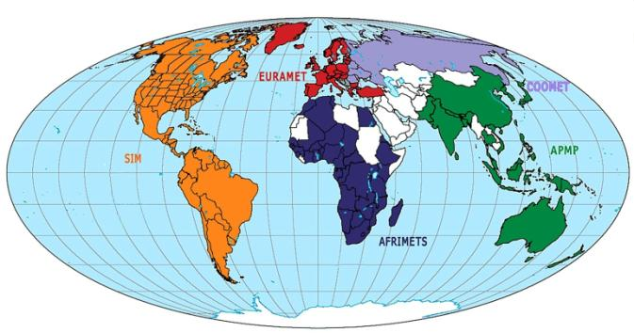



A NEW ALGORITHM FOR CLOCK WEIGHTS
FOR THE SIM TIME SCALE

Slide 5
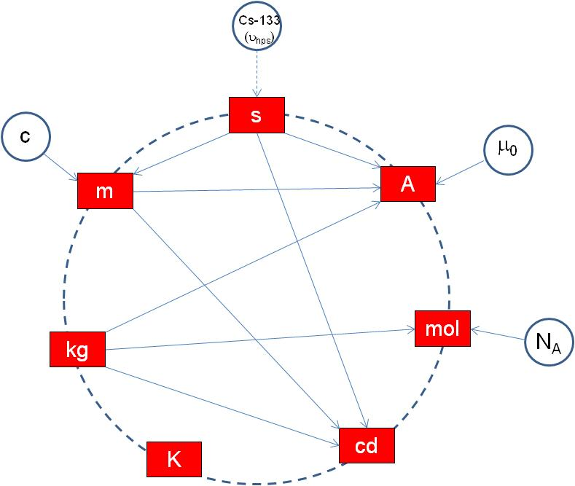
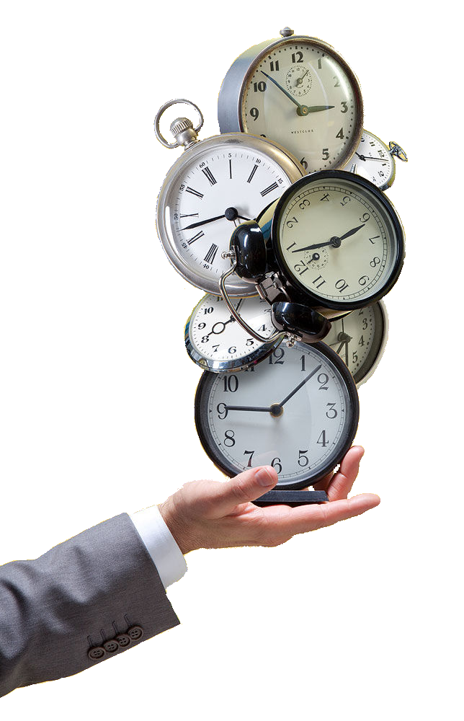
TWO FACES OF TIME
Scientific and fundamental research
Technological and practical applications
The current SI
Time is the most accurate measurement
TIME
The most measured physical quantity

Slide 6
A NEW ALGORITHM FOR CLOCK WEIGHTS
FOR THE SIM TIME SCALE
J. Mauricio Lopez R., Michael A. Lombardi, N. Diaz-Muñoz and Eduardo de Carlos Lopez
OUTLINE
1. Motivations
✓
2. The SIM Time Network (SIMTN)
3. The SIM time scale (SIMT)
4. New weights algorithm
5. Conclusions and future work

Slide 7
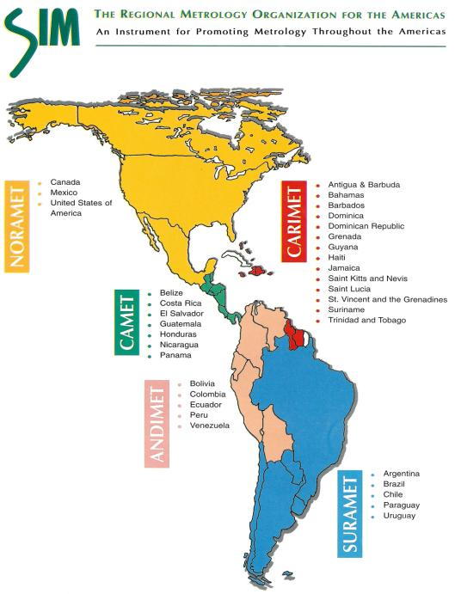

TIME AND FREQUENCY METROLOGY WORKING GROUP
Working to support time and frequency metrology throughout the Americas
34 NMIs
3 NMIs
14 NMIs
7 NMIs
5 NMIs
5 NMIs

Slide 8
TIME AND FREQUENCY METROLOGY WORKING GROUP
Working to support time and frequency metrology throughout the Americas
Current SIMTN members
18 +1
✓
✓
✓
✓
✓
✓
✓
✓
✓
✓
✓
✓
✓
✓
✓
✓
✓
✓

Slide 9
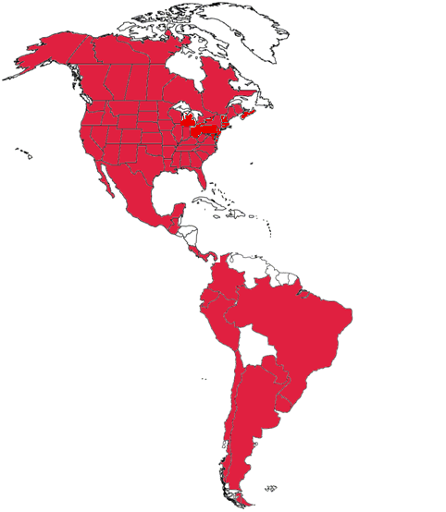
TIME AND FREQUENCY METROLOGY WORKING GROUP
Working to support time and frequency metrology throughout the Americas
SIMTN Area Coverage
18 +1 SIM NMIs

Slide 10
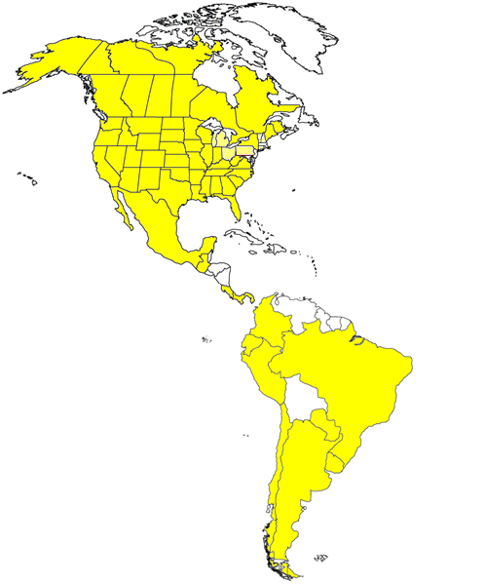
A NEW ALGORITHM FOR CLOCK WEIGHTS
FOR THE SIM TIME SCALE
Clock A
Clock B

Slide 11
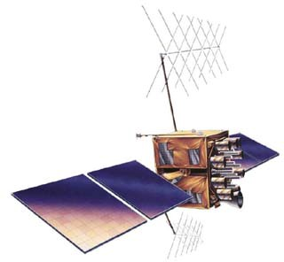
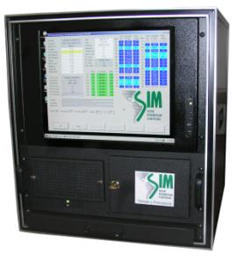
A NEW ALGORITHM FOR CLOCK WEIGHTS
FOR THE SIM TIME SCALE
Clock A
GPS satellite
Measuring system A
Measuring system B
Clock B

Slide 12
A NEW ALGORITHM FOR CLOCK WEIGHTS
FOR THE SIM TIME SCALE
Clock A
GPS satellite
Measuring system A
GPS –Clock A
Measuring system B
GPS – clock B
Clock B
Time of the day
Time of the day

Slide 13
A NEW ALGORITHM FOR CLOCK WEIGHTS
FOR THE SIM TIME SCALE
SIMTN servers
NRC
Clock A
NIST
Measuring system A
CENAM
ONRJ
GPS –Clock A
Measuring system B
GPS – clock B
Clock B
Time of the day
Time of the day

Slide 14
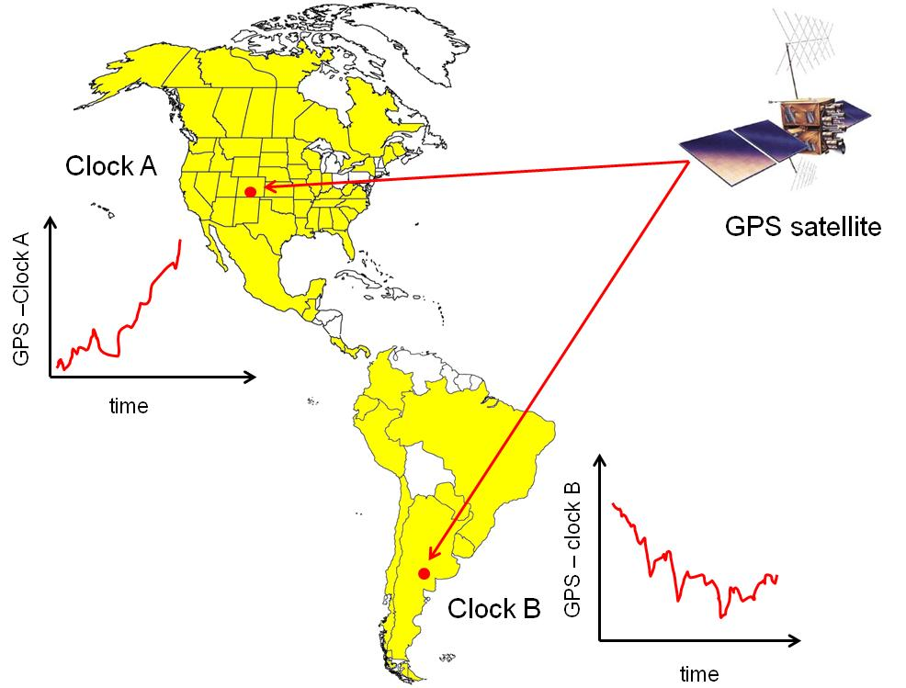
A NEW ALGORITHM FOR CLOCK WEIGHTS
FOR THE SIM TIME SCALE
GPS – clock B
Clock A – Clock B ± u
GPS –Clock A
Time of the day
Time of the day
time
(Clock A – S) – (Clock B – S) = (Clock A – Clock B) + (d_{SA} – d_{SB})

Slide 15
A NEW ALGORITHM FOR CLOCK WEIGHTS
FOR THE SIM TIME SCALE
links in the SIMTN
CENAM
LNM
ICE
NIST
N_{C} number of bilateral comparisons
CENAMEP
N number of laboratories in the network
NRC
SIC
For
N=18
there are
N_{C} = 153
bilateral comparisons
SLBS
ONRJ
BSJ
INDP
INTI
INTN
UTE

Slide 16
A NEW ALGORITHM FOR CLOCK WEIGHTS
FOR THE SIM TIME SCALE
links in the SIMTN
CENAM
LNM
ICE
NIST
N_{C} number of bilateral comparisons
CENAMEP
N number of laboratories in the network
NRC
SIC
For
N=18
there are
N_{C} = 153
bilateral comparisons
SLBS
ONRJ
BSJ
INDP
INTI
INTN
UTE

Slide 17
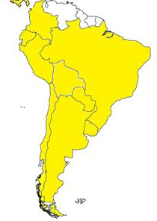
A NEW ALGORITHM FOR CLOCK WEIGHTS
FOR THE SIM TIME SCALE
links in the SIMTN
CENAM
LNM
ICE
Longest link
NIST
8676.511 km baseline
USA to Argentina
CENAMEP
NRC
SIC
SLBS
ONRJ
BSJ
Shortest link
INDP
215.301 km baseline
Argentina to Uruguay
INTI
INTN
UTE

Slide 18
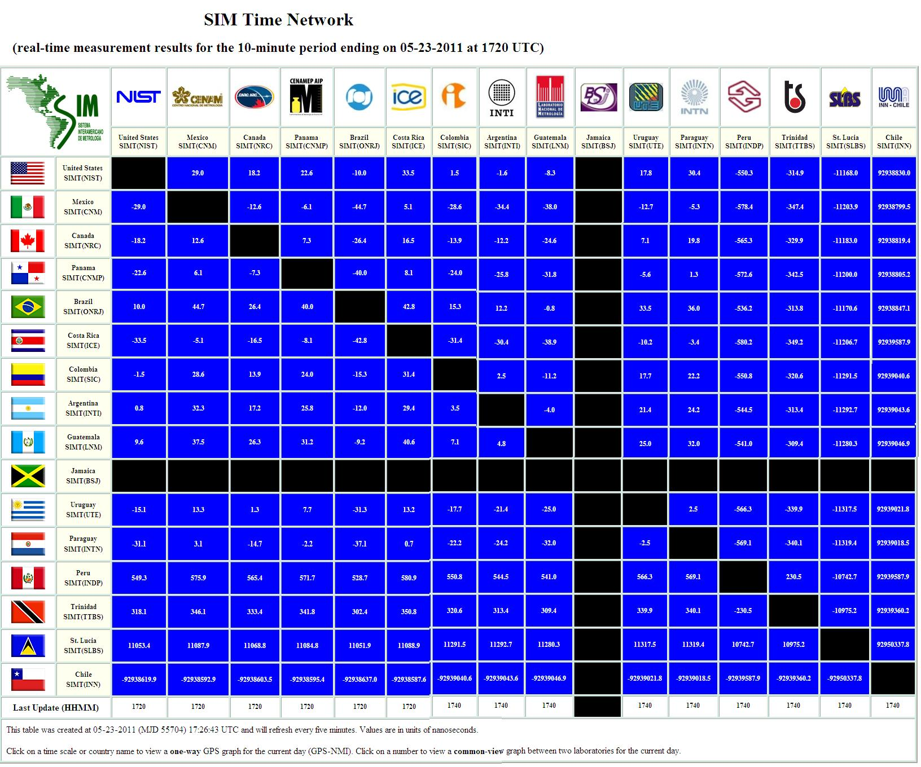
http://www.tf.nist.gov/sim

Slide 19
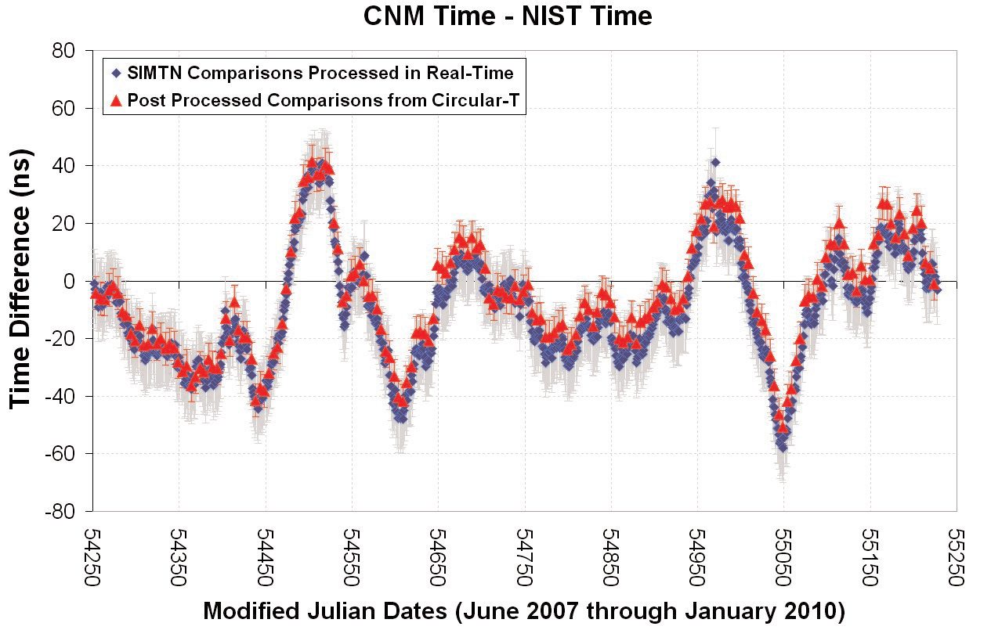
A NEW ALGORITHM FOR CLOCK WEIGHTS
FOR THE SIM TIME SCALE
CENAM Time – NIST time

Slide 20
A NEW ALGORITHM FOR CLOCK WEIGHTS
FOR THE SIM TIME SCALE
J. Mauricio Lopez R., Michael A. Lombardi, N. Diaz-Muñoz and Eduardo de Carlos Lopez
OUTLINE
1. Motivations
2. The SIM Time Network (SIMTN)
✓
3. The SIM time scale (SIMT)
4. New weights algorithm
5. Conclusions and future work

Slide 21
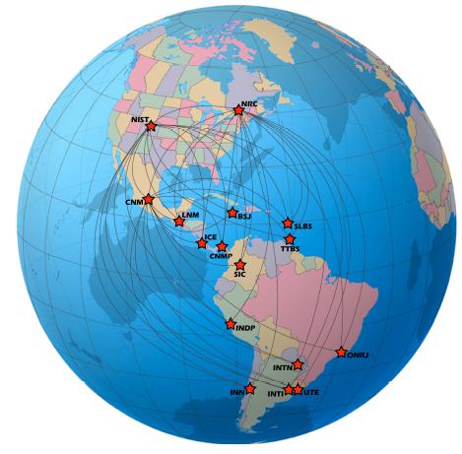
A NEW ALGORITHM FOR CLOCK WEIGHTS
FOR THE SIM TIME SCALE
∼ 30 Cesium beam clocks
9 Active Hydrogen Masers
1 Cs fountain clock (NIST)
2 Cs fountain clocks in progress
(NRC and CENAM)
4 ensemble time scales
(NRC, NIST, CENAM and ONRJ)

Slide 22
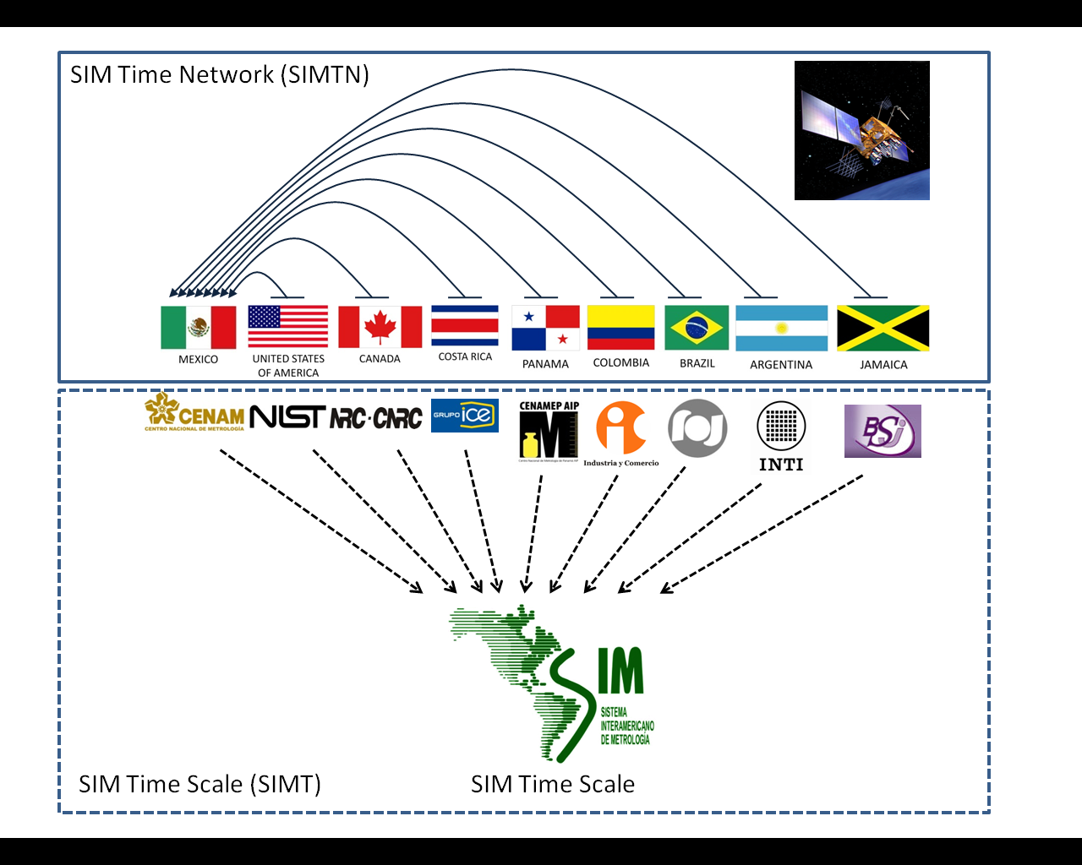
A NEW ALGORITHM FOR CLOCK WEIGHTS
FOR THE SIM TIME SCALE

Slide 23
A NEW ALGORITHM FOR CLOCK WEIGHTS
FOR THE SIM TIME SCALE
1.57542 GHz (L1 carrier)
GPS satellites
SIMT Computer (CENAM)
(reads SIMTN data feeds, runs SIMT algorithms, generates SIMT every hour)
GPS antenna
SIMTN data feeds (HTTP)
SIMT(k)
(clock or time scale)
8-channel GPS Receiver
FTP
(new data every hour)
10 MHz
1 pps
1 pps
SIMTN Web Server (NIST)
(publishes comparisons every 10 minutes)
(publishes SIMT every hour)
FTP
FTP Server (NIST)
(processes CVGPS and AVGPS data)
Time Interval Counter
New data every 10 minutes
FTP
FTP Server (CENAM)
(processes CVGPS and AVGPS data)
SIMTN Web Server (CENAM)
(publishes comparisons every 10 minutes)
SIMTN Computer
FTP
FTP Server (NRC)
(processes CVGPS and AVGPS data)
SIMTN Web Server (NRC)
(publishes comparisons every 10 minutes)
k-th member of SIMTN
(18 members)

Slide 24
A NEW ALGORITHM FOR CLOCK WEIGHTS
FOR THE SIM TIME SCALE
Taylor series expansion on the predicted time difference of clock k respect to SIMT
Time difference between clock k and SIMT at the time t (0th order aproximation)
Correction due to sistematic frequency difference between clock k and SIMT (1st order aproximation)
Prediction of the time difference between clock k and SIMT at the future time t+τ
Correction due to non constant (linear) frequency difference between clock k and SIMT (2th order aproximation)

Slide 25
A NEW ALGORITHM FOR CLOCK WEIGHTS
FOR THE SIM TIME SCALE
Averaging
Time difference between clock k and SIMT at the current time t+τ
Prediction of the time difference between clock j and SIMT made at the past time t
Time difference between clock j and clock k at the time t+τ

Slide 26
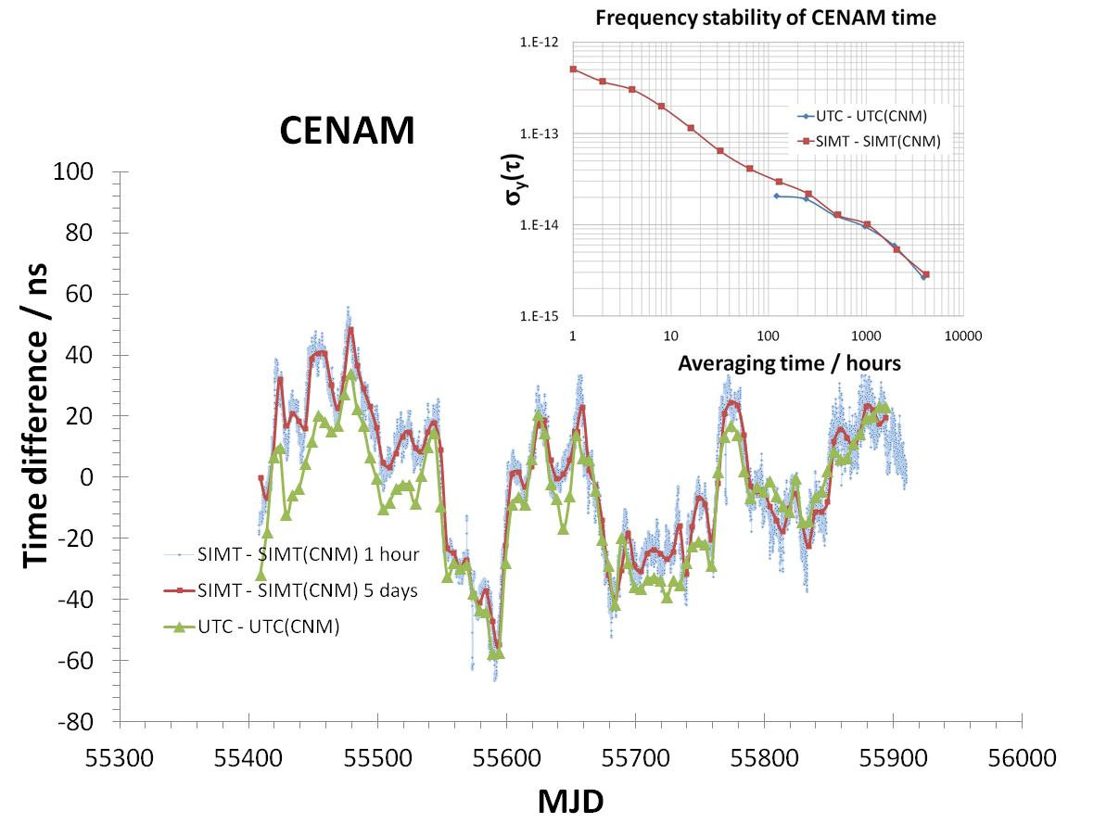
A NEW ALGORITHM FOR CLOCK WEIGHTS
FOR THE SIM TIME SCALE

Slide 27
A NEW ALGORITHM FOR CLOCK WEIGHTS
FOR THE SIM TIME SCALE
J. Mauricio Lopez R., Michael A. Lombardi, N. Diaz-Muñoz and Eduardo de Carlos Lopez
OUTLINE
1. Motivations
2. The SIM Time Network (SIMTN)
3. The SIM time scale (SIMT)
✓
4. New weights algorithm
5. Conclusions and future work

Slide 28
A NEW ALGORITHM FOR CLOCK WEIGHTS
FOR THE SIM TIME SCALE
Since February, 2012

Slide 29
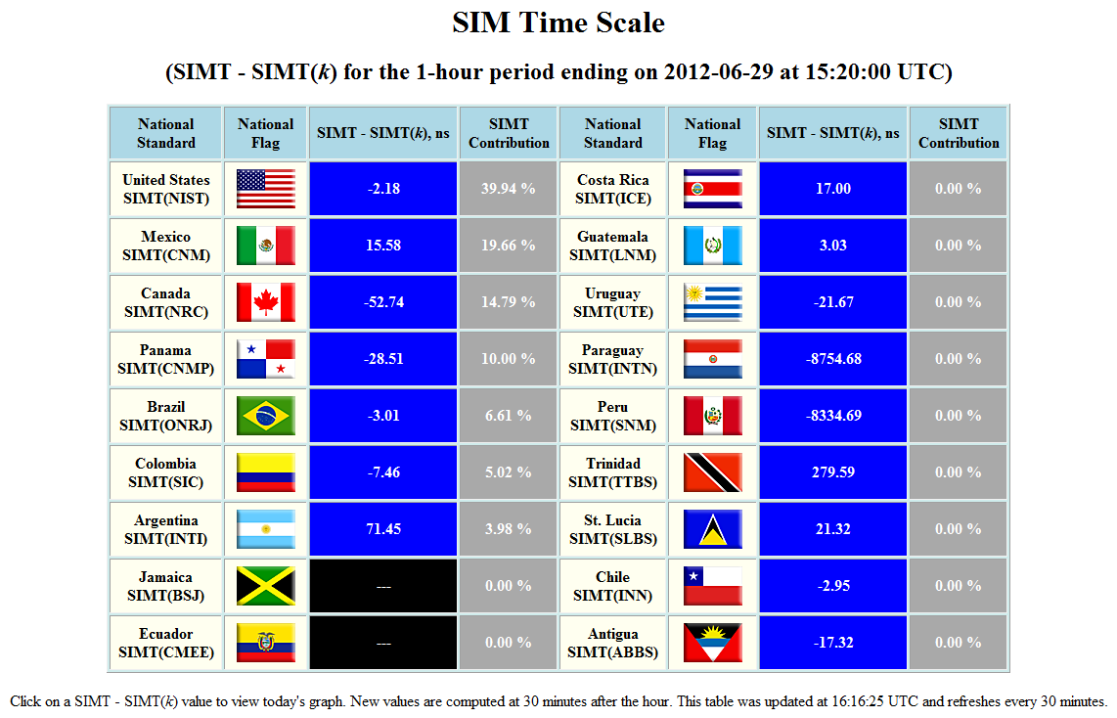
A NEW ALGORITHM FOR CLOCK WEIGHTS
FOR THE SIM TIME SCALE

Slide 30
A NEW ALGORITHM FOR CLOCK WEIGHTS
FOR THE SIM TIME SCALE
February 9, 2012

Slide 31
A NEW ALGORITHM FOR CLOCK WEIGHTS
FOR THE SIM TIME SCALE

Slide 32
A NEW ALGORITHM FOR CLOCK WEIGHTS
FOR THE SIM TIME SCALE

Slide 33
A NEW ALGORITHM FOR CLOCK WEIGHTS
FOR THE SIM TIME SCALE

Slide 34
A NEW ALGORITHM FOR CLOCK WEIGHTS
FOR THE SIM TIME SCALE

Slide 35
A NEW ALGORITHM FOR CLOCK WEIGHTS
FOR THE SIM TIME SCALE

Slide 36
A NEW ALGORITHM FOR CLOCK WEIGHTS
FOR THE SIM TIME SCALE

Slide 37
A NEW ALGORITHM FOR CLOCK WEIGHTS
FOR THE SIM TIME SCALE

Slide 38
A NEW ALGORITHM FOR CLOCK WEIGHTS
FOR THE SIM TIME SCALE
J. Mauricio Lopez R., Michael A. Lombardi, N. Diaz-Muñoz and Eduardo de Carlos Lopez
OUTLINE
1. Motivations
2. The SIM Time Network (SIMTN)
3. The SIM time scale (SIMT)
4. New weights algorithm
✓
5. Conclusions and future work

Slide 39
A NEW ALGORITHM FOR CLOCK WEIGHTS
FOR THE SIM TIME SCALE
3 +1 SIMTN servers
NRC
NIST
CENAM
ONRJ

Slide 40
A NEW ALGORITHM FOR CLOCK WEIGHTS
FOR THE SIM TIME SCALE
Computation of SIMT in 3 different locations
NRC
NIST
CENAM

Slide 41
A NEW ALGORITHM FOR CLOCK WEIGHTS
FOR THE SIM TIME SCALE
✓
✓
✓
✓
✓
✓
✓
✓
✓
✓
Cs clock(s) will be included
✓
SIMT(k) will be steered to SIMT

Slide 42

A NEW ALGORITHM FOR CLOCK WEIGHTS
FOR THE SIM TIME SCALE
18 SIM NMIs
+
Bolivia

Slide 43
A NEW ALGORITHM FOR CLOCK WEIGHTS
FOR THE SIM TIME SCALE
More room to improve the SIMT stability

Slide 44
A NEW ALGORITHM FOR CLOCK WEIGHTS
FOR THE SIM TIME SCALE
Development of new SIM GPS systems with full compatibility with the BIPM algorithm to produce the UTC (in progress). More SIM NMIs contributing data to TAI.

Slide 45
A NEW ALGORITHM FOR CLOCK WEIGHTS
FOR THE SIM TIME SCALE
J. Mauricio Lopez R., Michael A. Lombardi, N. Diaz-Muñoz and Eduardo de Carlos Lopez
J. Mauricio Lopez R.¹, Michael A. Lombardi², N. Diaz-Muñoz¹ and Eduardo de Carlos Lopez¹,
¹Centro Nacional de Metrología (CENAM), Querétaro, Mexico
²National Institute of Standards and Technology (NIST), Boulder, Colorado, United States,
THANK YOU FOR YOUR ATTENTION!

